Slide 1

Introduction
She Inspires Hackathon
GROUP 10 : THE VERDA
Presented By:
Mitali Joshi
Diya Patel
Anushka Gangakhedkar
Anagha Bahekar
Shruti Thorat
Kalyani Pachbhai 7.Sanskruti Pokharkar
8.Pooja Matsagar
Mentor Name:
Sai Ramya

Slide 2
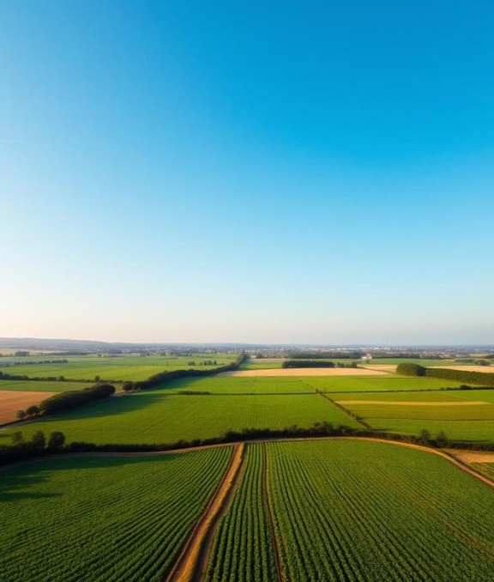
Problem Statement
We propose a Document Analysis Assistant using AWS Party Rock to simplify agricultural regulations, government schemes, and certifications. It will break down complex policies, highlight key eligibility criteria, and guide farmers through application processes with step-by-step assistance.

Slide 3




Existing Solutions Are Inadequate:
Government websites and manuals :
Consultants :
Dense, hard to understand.
Expensive, inaccessible to small farmers.
Generic AI :
Lacks specialized agricultural knowledge.
75% of farmers struggle with regulatory requirements.

Slide 4
Our Solution : AgriGuide for Farmers
Upload Documents :
Simplified Explanation:
Policies, Guidelines
Applications and
Summaries of key points
Personalised Guidance :
Based on farm Specifics

Slide 5
Simplifying Complex Agricultural Policies
Clear Interpretation :
Understandable Components :
The Document Analysis Assistant is designed to interpret agricultural policies in clear, accessible language, simplifying complex regulatory documents.
By breaking down policies into understandable components, the system ensures that farmers can easily grasp the essential details.
This ensures that farmers can easily understand all available opportunities for support and funding.

Slide 6
Implementation Steps
Implementing the Document Analysis Assistant involves a series of well-defined steps within the AWS PartyRock environment. From setting up the platform to defining
prompts and testing the model, each stage is efficiency. Deployment is streamlined, allowing quickly and easily.
crucial farmers
to ensure accuracy and to access the assistant
1
Set Up PartyRock
3
Define prompts
2
Select Model
4
Test and Deploy

Slide 7
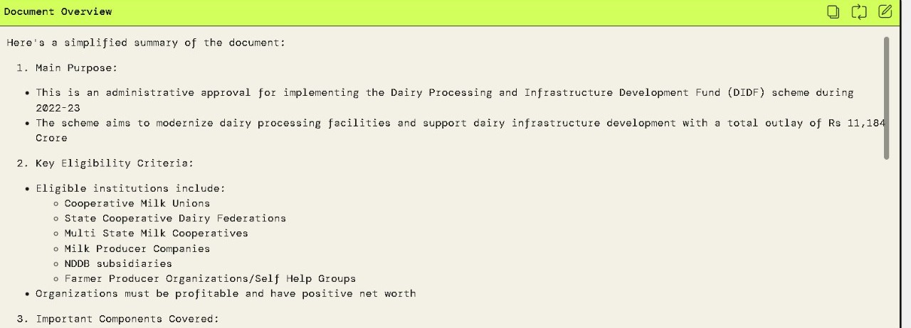
Document
Requires clear, concise, and well-structured data. Model Used: Claude 3.5 Sonnet
Temperature: 0.4
Top-P: 0.9

Slide 8
Temperature and Top-p
In AWS PartyRock ,Temperature and Top-p are hyperparameters that control the randomness and creativity of AI-generated responses.
Temperature
Controls randomness in AI responses. Range : Usually 0 to 1
Top-p (Nucleus Sampling)
Controls diversity by limiting the selection of works to the most probable one. Range: 0 to 1

Slide 9
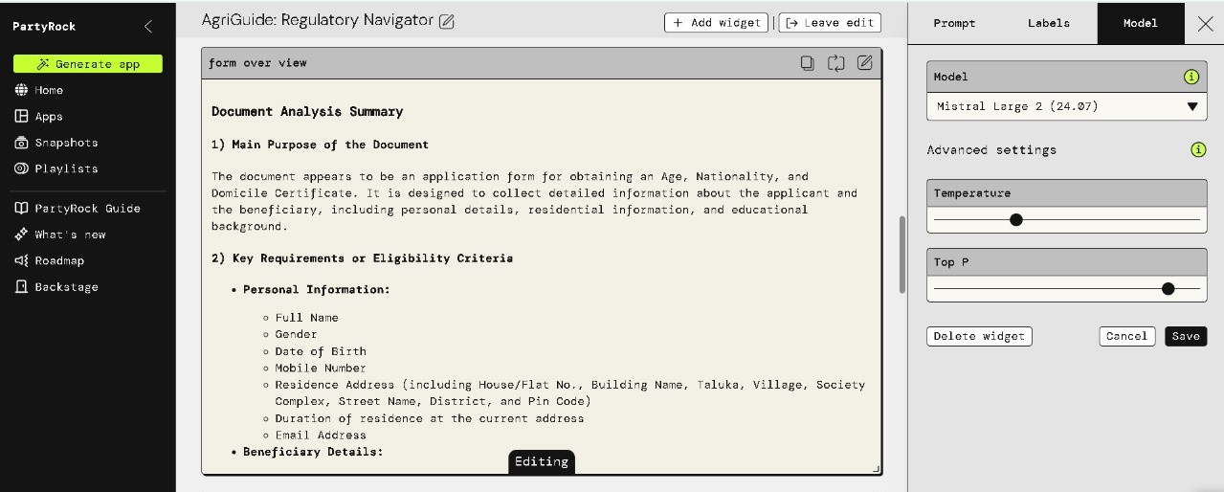
Certificate
Requires short, accurate, and well-structured data for clarity and efficiency. Model: Mistral Large 2
Temperature: 0.3
Top-P: 0.7

Slide 10
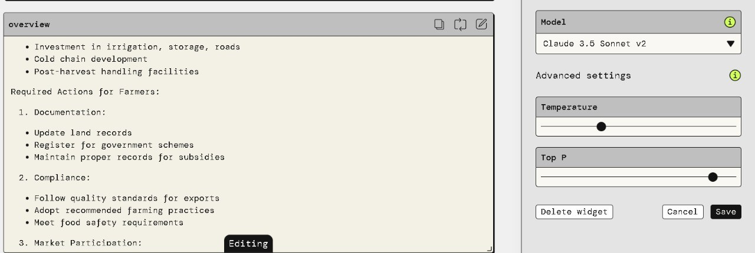
Policy
Requires the most balanced approach with accuracy, clarity and efficiency Model: Claude 3.5 Sonnet
Temperature: 0.4
Top-P: 0.9

Slide 11
Why AgriGuide?
Simplifies Complex Documents
Saves Time & Reduces Manual Efforts Increase Accessibility
Reduces Errors in Applications Scalable & Cost-Effective

Slide 12
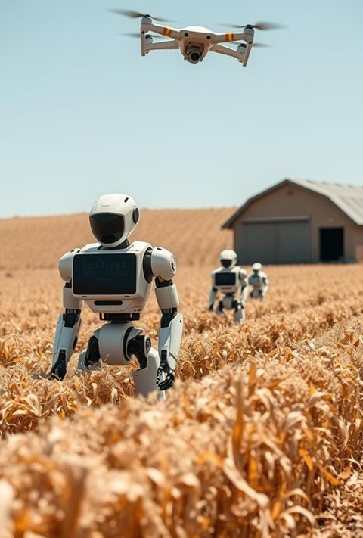
Conclusion: Revolutionizing Agricultural Compliance
Our AI-powered Document Analysis Assistant leverages AWS PartyRock to simplify agricultural policies, government schemes, and certification processes for farmers. By using advanced AI models like Amazon Nova Pro and Claude v2, we provide clear explanations, step-by- step form assistance, and easy access to benefits. This solution bridges the gap between complex regulations and practical implementation, empowering farmers with knowledge and automation. With scalability, multilingual support, and user-friendly accessibility, it has the potential to enhance efficiency, financial security, and digital adoption in agriculture.🌾🚀

Slide 13
Next Steps: Empowering Farmers with AI
By providing farmers with an intelligent, easy-to-use tool, we can revolutionize agricultural compliance, unlocking new opportunities for growth and sustainability. Our next steps include:
Developing a prototype using AWS PartyRock technology. Conducting user testing with farmers to refine the system.
Integrating the assistant with existing agricultural platforms.
With this innovative solution, we aim to empower farmers to focus on what they do best: producing high-quality food while maintaining full regulatory compliance.

Slide 14
Live Demo
https://partyrock.aws/u/shruti19/0wn8aDmc5/AgriGuide%3A-Regulatory-Navigator

Slide 15
Thank You!

